Slide 1
SQLiteStudio
&
Data Types

Slide 2
The Question
How do I import an excel spreadsheet into SQLite to create a database?
The Result?
- An answered question leading to a lot more questions.
- We love errors
Notes:
I love errors because they actually tell you when you're doing something wrong. Instead of not telling you anything at all…

Slide 3
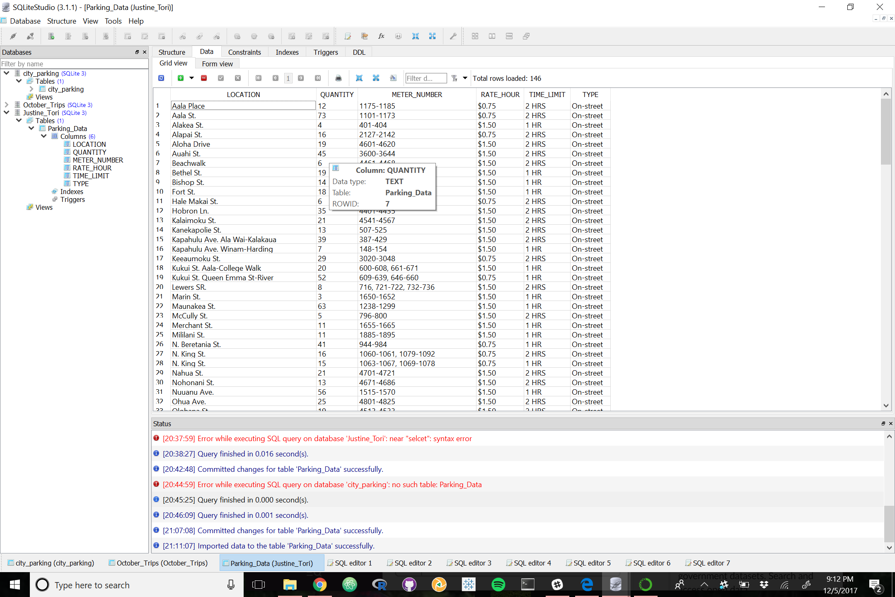
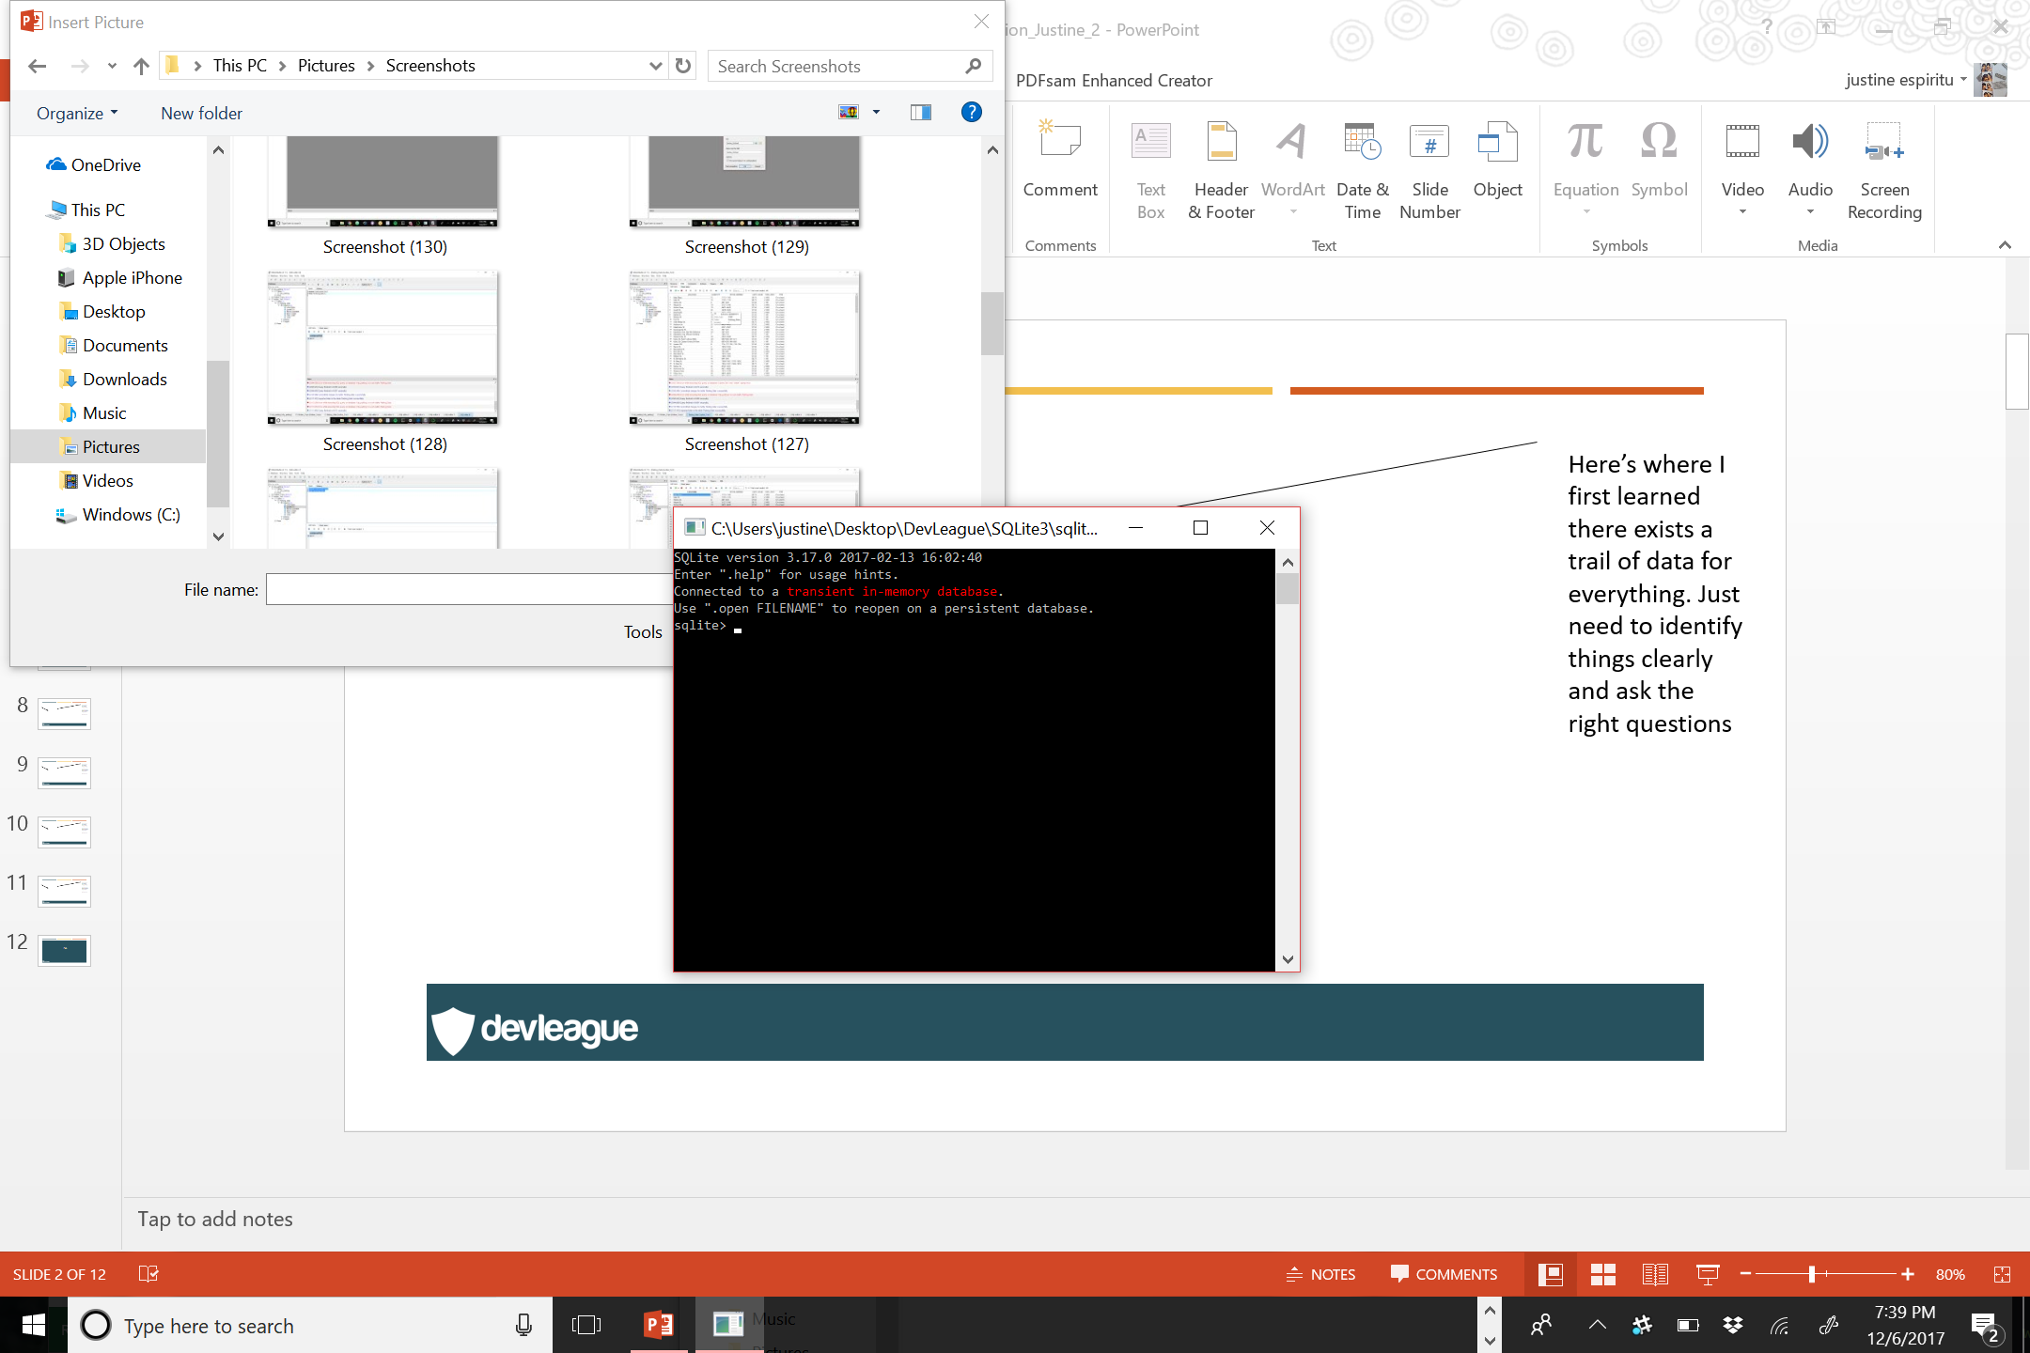
SQLite3 Command Line
I prefer to work with SQLite databases using an intuitive GUI tool.
Notes:
JUSTINE

Slide 4
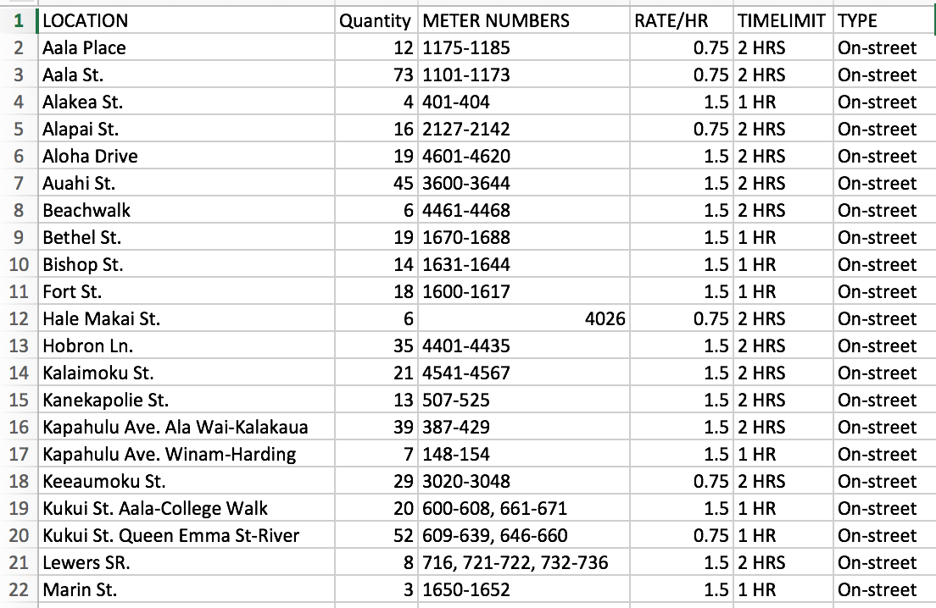
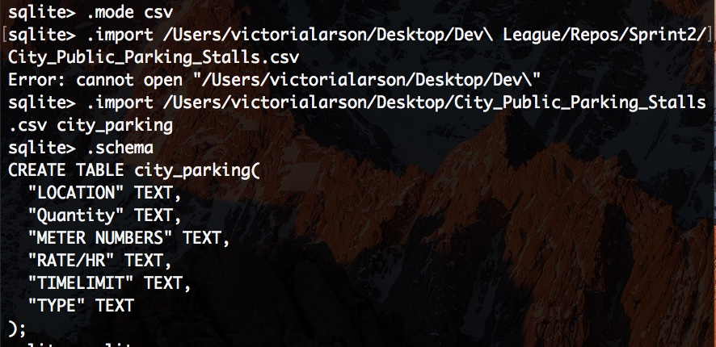
SQLite 3 and the Command Line
Notes:
Wanted to analyze public parking data CSV file by importing it into SQL and creating a database.
When importing the data into SQLite I learned that you write the file path and then you put the name you would like to name it directly after.
These are my headers
One thing we found interesting was that all of the data points were put into SQL as text even though some of them were integers.

Slide 5
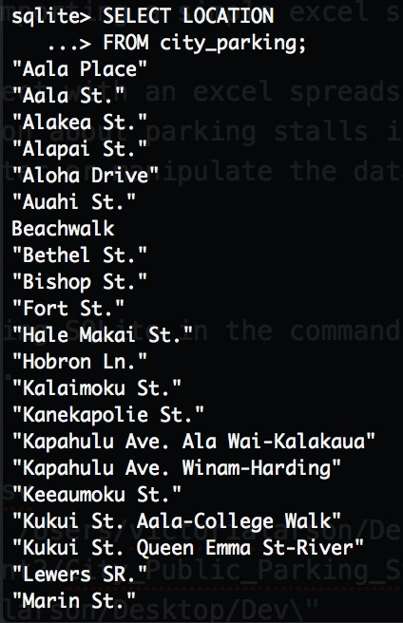
Tori’s First Query
SELECT LOCATION
FROM city_parking
;
Very Important
Notes:
But I ran my first query
Learned about the SELECT and FROM functions
In this example I used
SELECT LOCATION – which was one of my columns
FROM my newly named city_parking
Learned about the very important semicolon. You can type forever and nothing will happen without a semicolon.

Slide 6
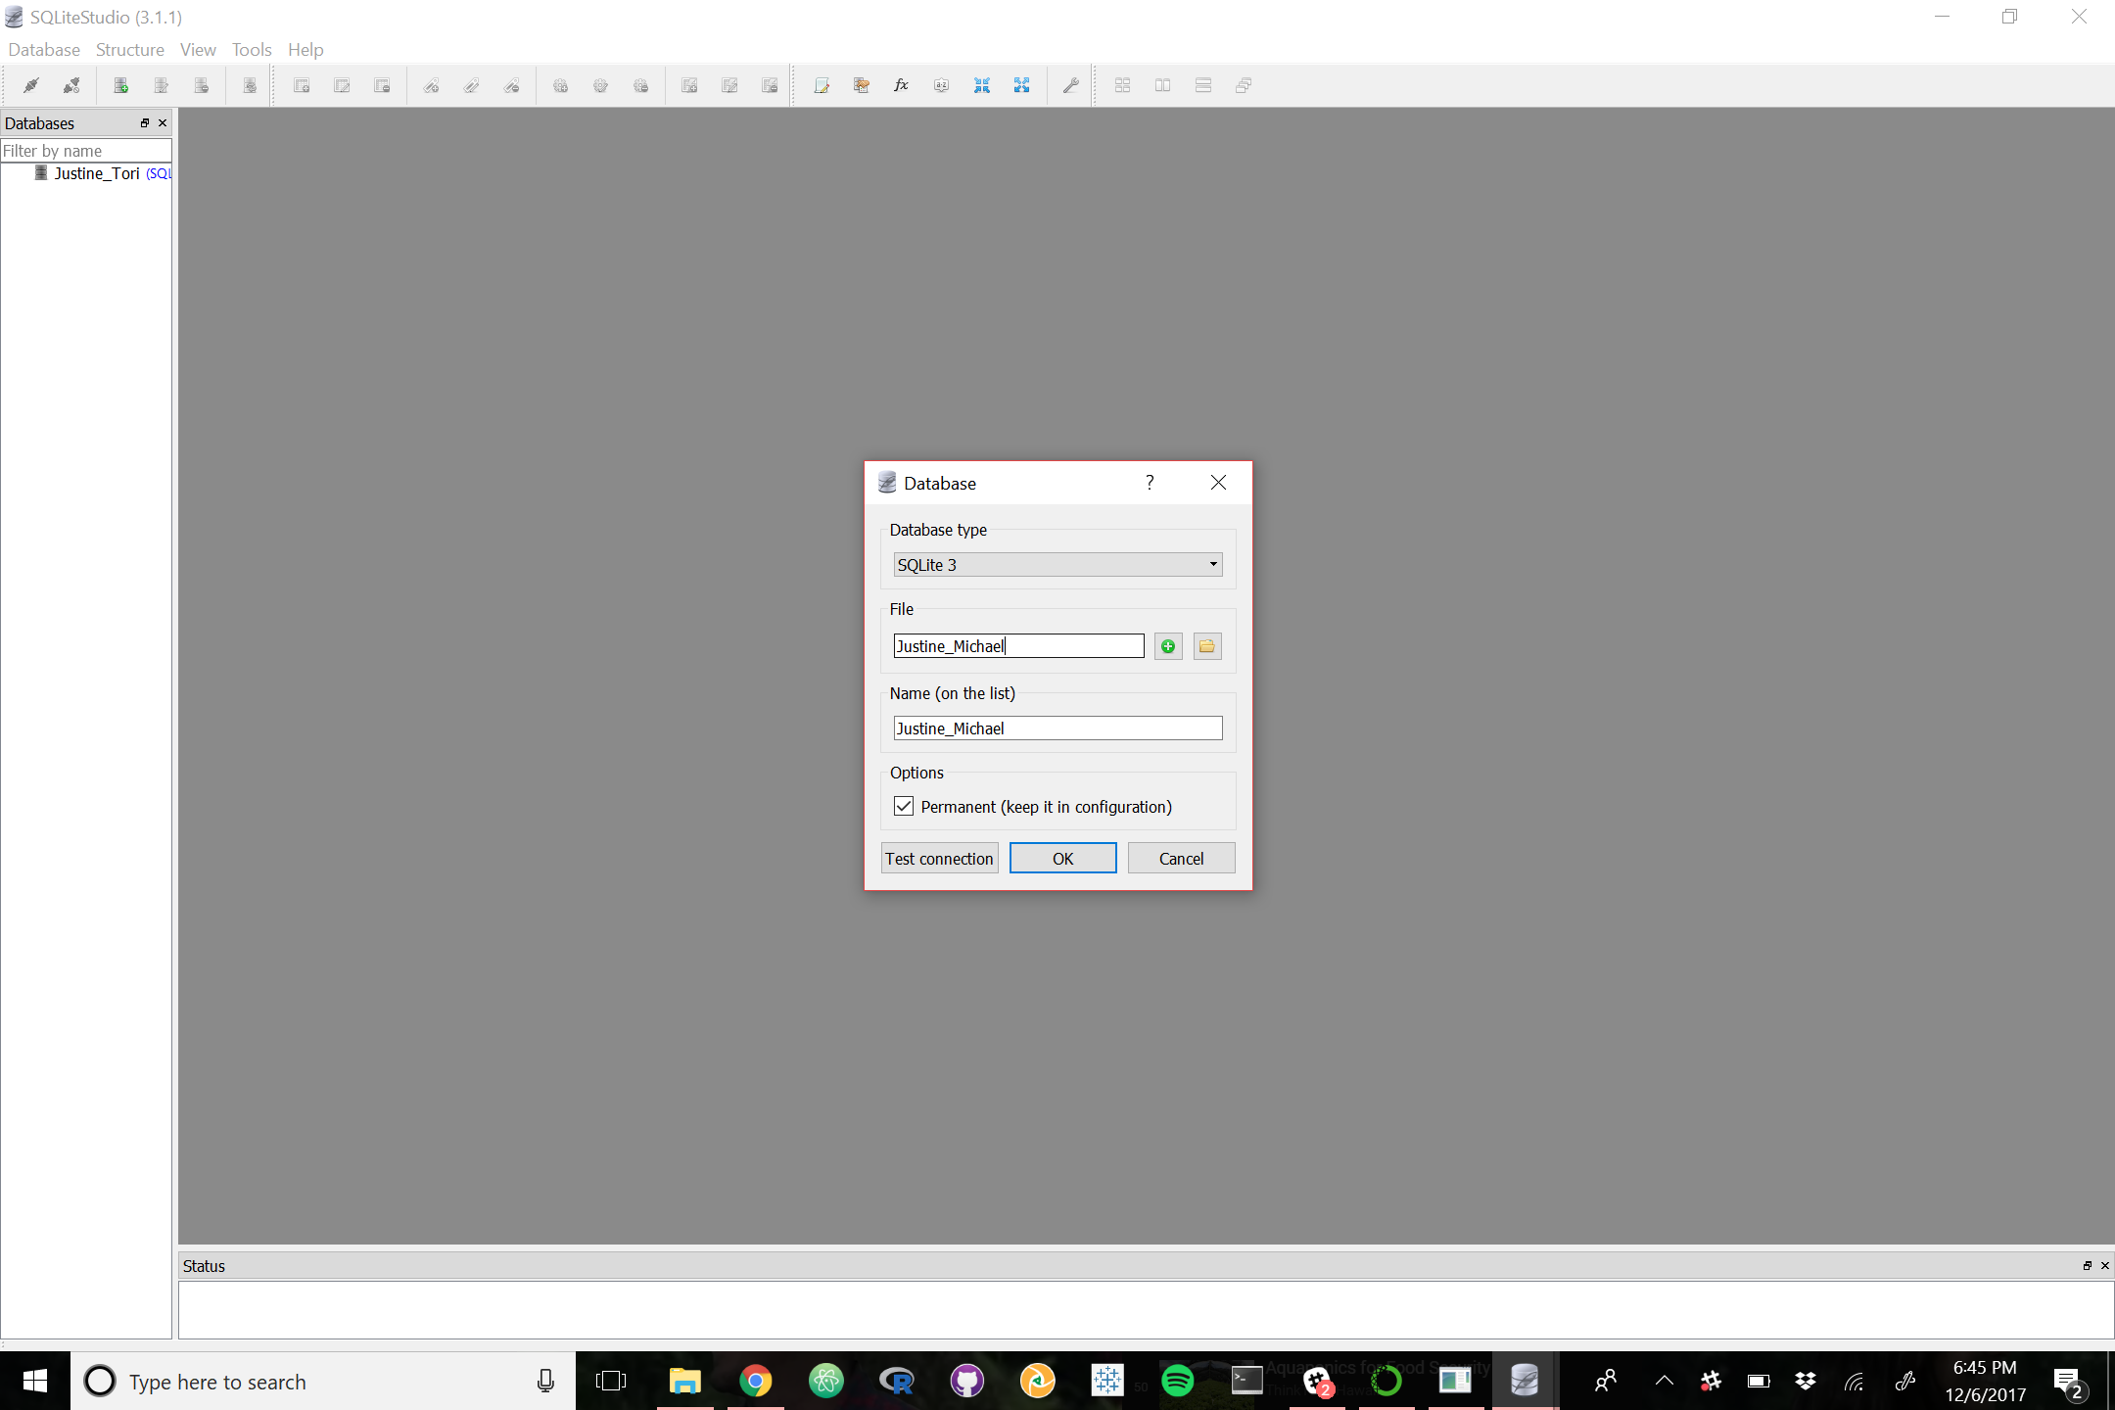
Notes:
justine

Slide 7

Notes:
justine

Slide 8
Notes:
justine

Slide 9
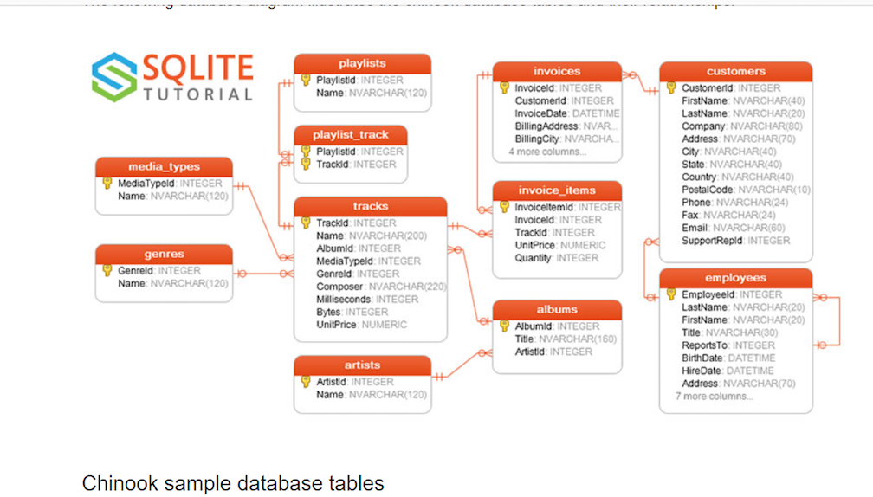
Notes:
Justine

Slide 10
DATA TYPE = TEXT?
Data types are all ”TEXT”?
This data set should be labeled as an Integer not a text.
Notes:
After running the query We wanted to upload the same table into SQLite studio.
Like I said earlier we noticed that in SQLite command line all of the data types were text.
This didn’t make any sense to us because some of the values, like QUANTITY were not supposed to be text, but integers.
We were also afraid it would effect our work when working with the data in the future.

Slide 11
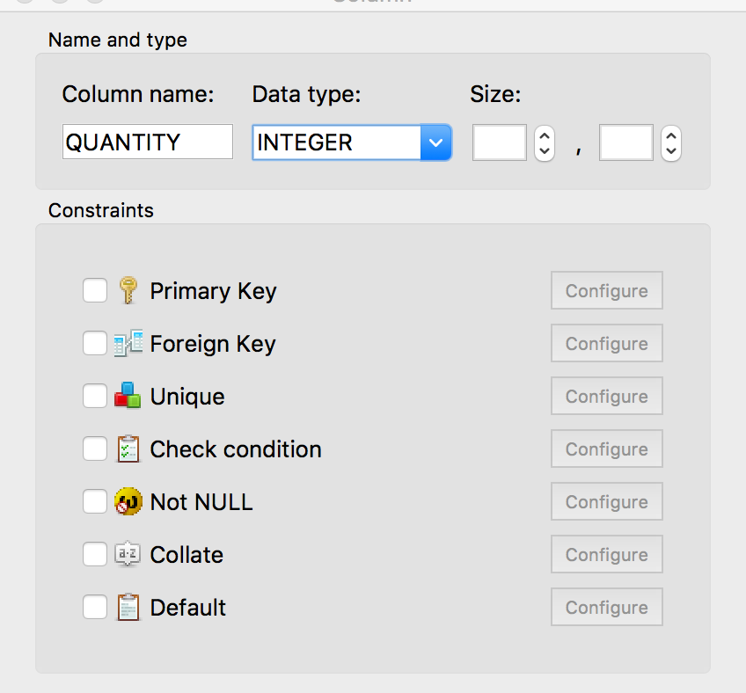
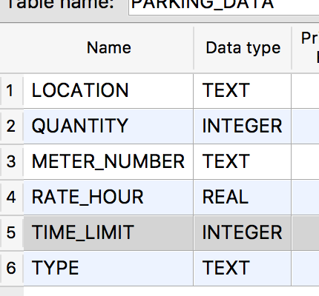
Creating a Database in SQLiteStudio
Created Headers from scratch then Imported the Data
Notes:
We tried to combat this problem by making the table in SQLiteStudio from scratch and presetting the datatypes then importing the data after!
So we created all of the column names and inputted what we thought should go in there.
We learned that:
A word like – “on-street parking” is a text data type
But a number like in “quantity” of spaces is an integer.
This is what we came up with!

Slide 12
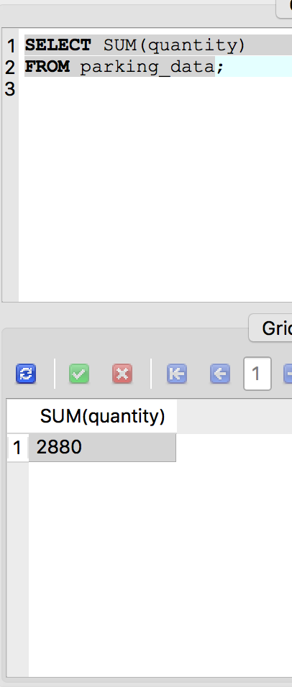
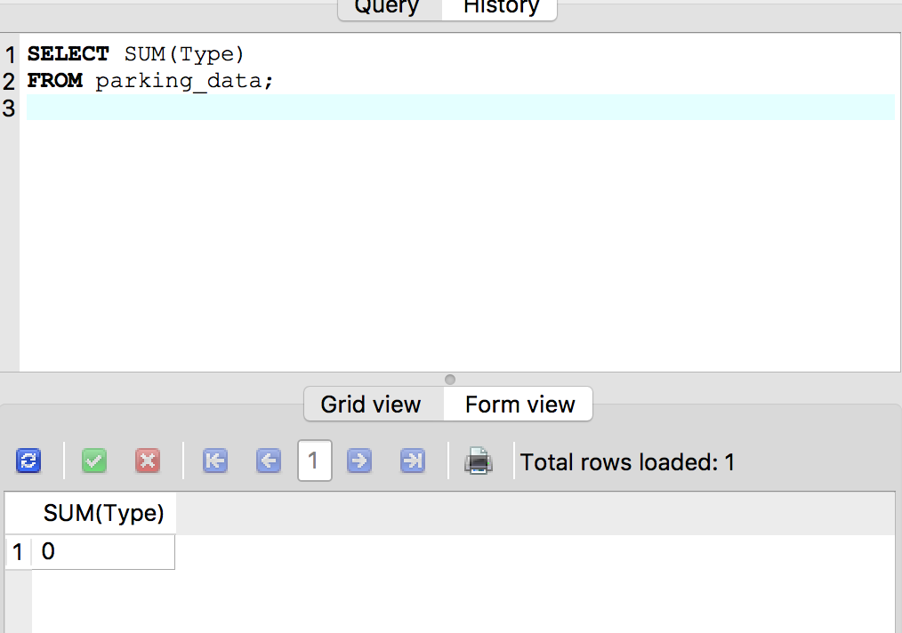
What? No Error?
Notes:
So in our experimenting we wanted to see if setting the correct data types to the data worked.
And it seemed to! When we ran a query for a sum function with quantity and it added all of the numbers together!
Just for fun we tried adding the type of parking together to see what would happen.
Since we set the data type of “parking_type” as a text it should have run an error because you shouldn’t be able to add two pieces of text together. But it gave us “0” instead.

Slide 13
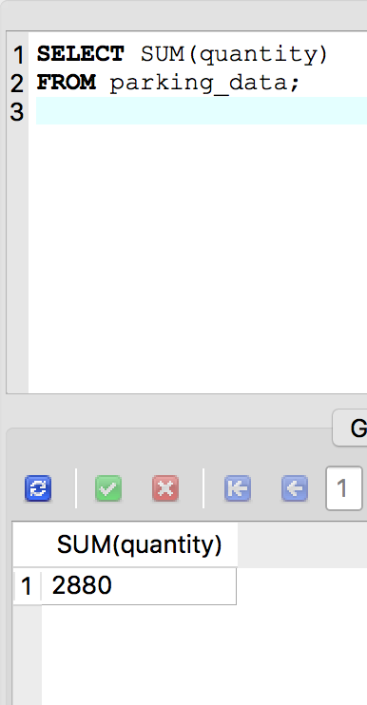
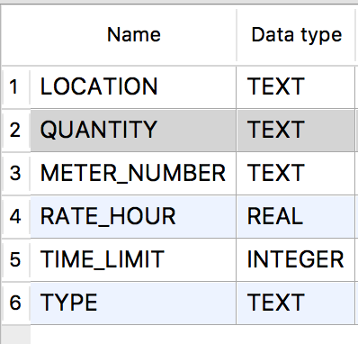
Continues to print as a number
instead of giving an error
Changed Quantity to TEXT
Notes:
So then I went back and saved quantity’s data type as a text to see if it would error out like it should since you cant add two pieces of text together.
My function printed the answer instead of giving me an error message. So I had to do more research.

Slide 14
Here is what I found!
Static/Rigid Typing
Notes:
There are two types of type systems Dynamic and Static
The first is static, which from what I understand is what I was trying to do where you assign the value to a datatype and that is the way it is stored. So if a number is stored as a text it will act as though it is a word.

Slide 15

Dynamic Type System
Notes:
The second is Dynamic type system – which is what SQLite uses. This type system associates the value of the variable with its actual value – not its data type – so if you assign of the datatype of a number as a text it will still print it as a number. So in my opinion Sqlite basically doesn’t have any rules. But its still important to assign the data types in the event that you use another program that only uses Static typing.

Slide 16
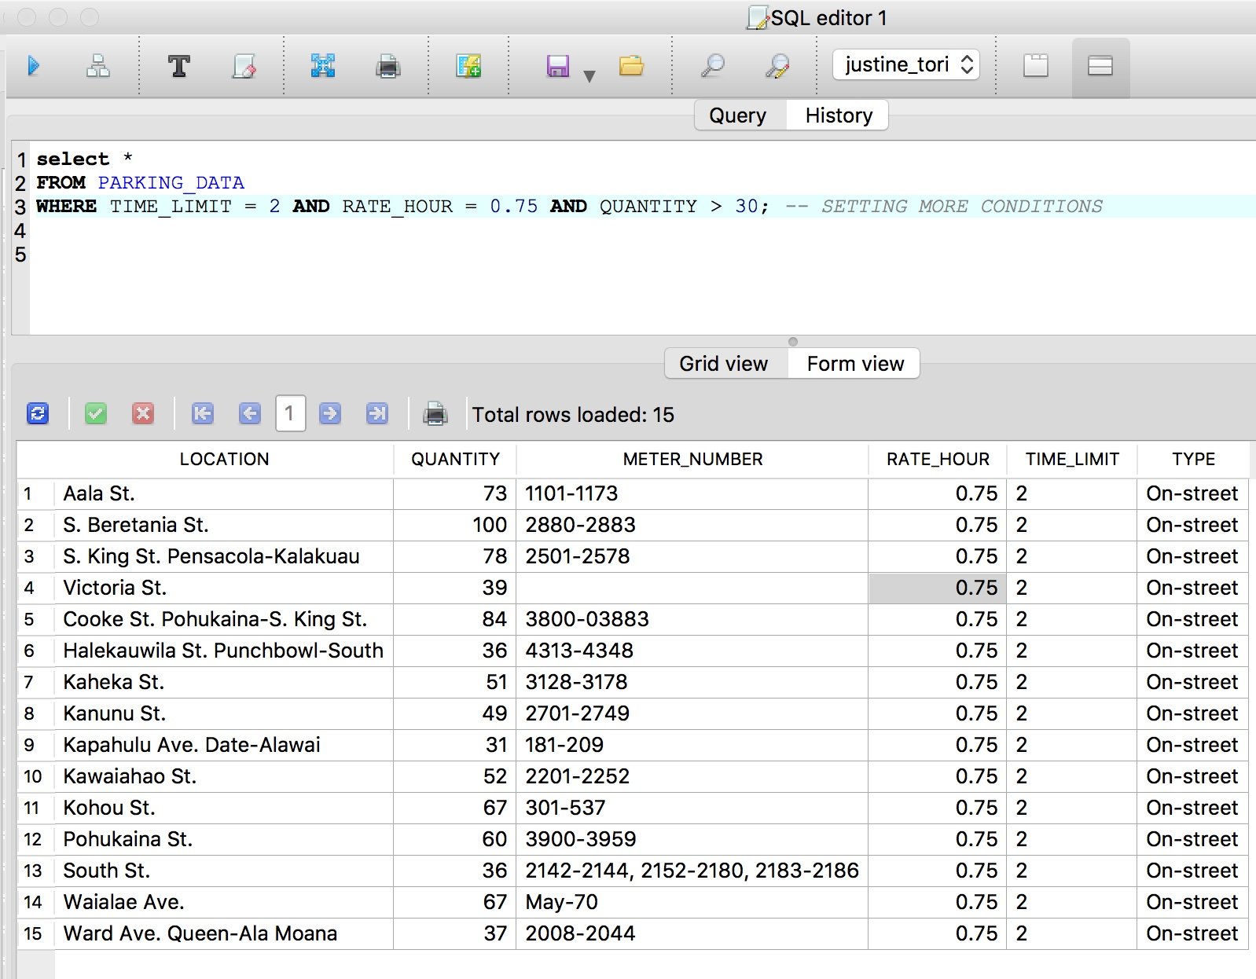
Ran some Queries
Notes:
Even in the sadness of not really understanding the rule less SQLite system I still wanted to show you some queries that I ran because it is what I set out to do. I learned how to set multiple rules with a query – here is one.
Want lots of time so my Time limit was 2 hours
I like a deal so I chose Cheapest hourly rate - .75
Scared of not finding a spot so i went to place with lots of stalls – greater than 30 stalls

Slide 17
We
Errors

Slide 18
The End!

